Slide 1
GEOG4/6300
Working with Raster and Vector Data: Visualizing and zonal statistics
Tuesday September 30, 2025
Dr. Anna Harper

Slide 2
Overview
Where are we in the class …
Review of calculating zonal statistics with vector data
Calculating zonal statistics from raster data

Slide 3
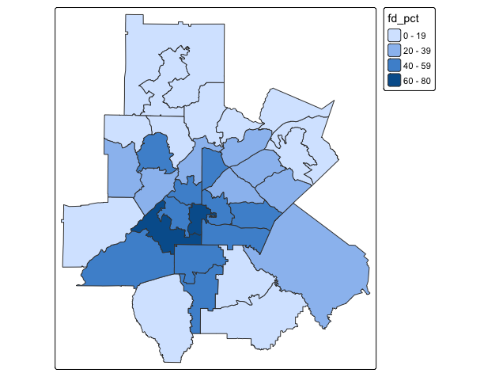
How did we calculate zonal statistics with vector data (on Tuesday)?
Dollar stores csv
Dollar stores vector
st_as_sf
st_join
Dollars_puma
Atlanta PUMAs geopackage
Atlanta PUMAs vector
st_join
st_read
Notes:
We removed the geometry in dollars_puma because we just want to count how many of each type of store is in each PUMA, we don’t care where it is. Also the pivot wider doesn’t work when each point has a geometry attached to it.

Slide 4
Joins
dollars_puma <- dollars %>%
st_join(atl_pumas %>% st_transform(4326), join=st_within) %>%
filter(is.na(GEOID)==FALSE)
st_join is a spatial join.
The %>% after dollars means to use dollars as the first argument for st_join.
?st_join
st_within: matches any feature in the first object (dollars) that falls completely inside a feature of the second object (atl_pumas).
Don’t return any stores that don’t fall within one of the GEOIDs

Slide 5
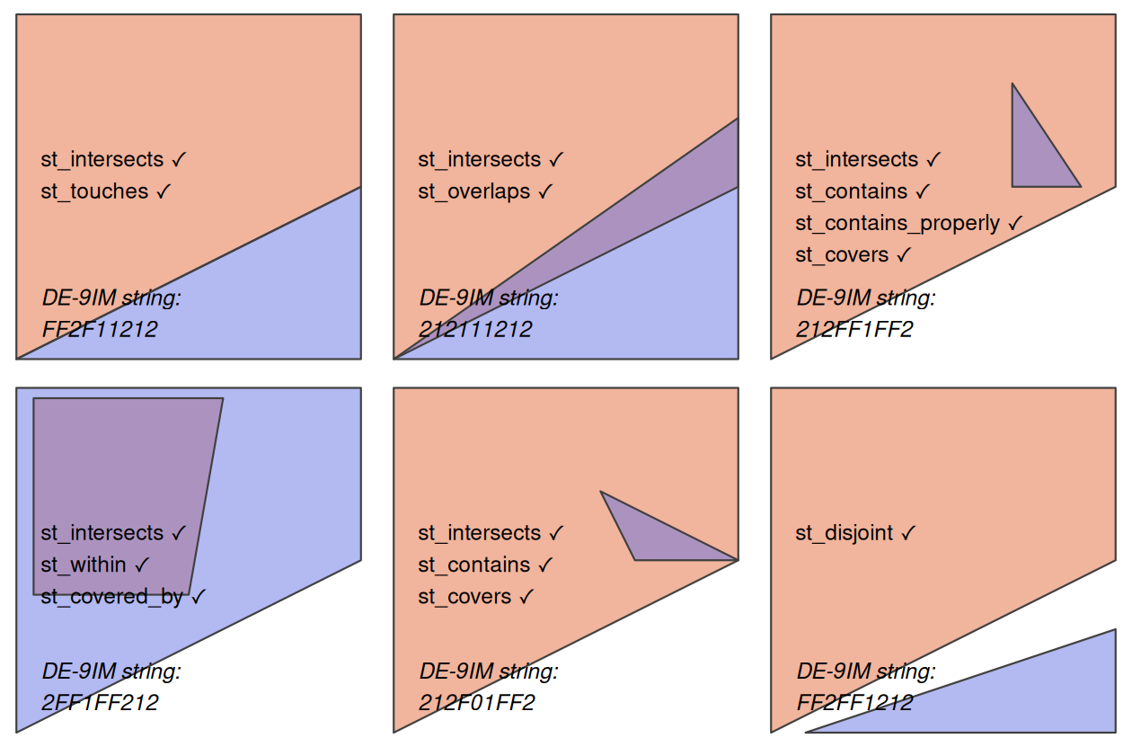
Topological relations
Describes the spatial relationships between objects
join(x,y): Order matters for within and contains
Here: x is pink and y is blue

Slide 6
How did we calculate zonal statistics with vector data (on Tuesday)?
Dollar stores csv
Dollar stores vector
st_as_sf
st_join
Dollars_puma
Dollars_puma_df
st_set_geometry
Atlanta PUMAs geopackage
Atlanta PUMAs vector
st_join
st_read
Atlanta PUMAs vector
left_join
Dollars_puma_df
Dollars_puma_count_wide
left_join
Count dollar_type in each GEOID
Pivot wider
Calculate total_stores and fd_pct
Notes:
We removed the geometry in dollars_puma because we just want to count how many of each type of store is in each PUMA, we don’t care where it is. Also the pivot wider doesn’t work when each point has a geometry attached to it.
We can’t map dollars_puma_count_wide because ... We had removed the geometry from dollars_puma!
Why can’t we do st_join? Because dollars_puma_count_wide is a dataframe, it’s not spatial

Slide 7
Joins
atl_pumas_join<-atl_pumas %>%
left_join(dollars_puma_count_wide)
Review S02-2 if you’re confused about joins, or week 2 content
https://mikoontz.github.io/data-carpentry-week/lesson_joins.html
Mutating joins add columns from y to x, matching observations based on the keys. There are four mutating joins: the inner join, and the three outer joins.
A left_join() keeps all observations in x.

Slide 8
How did we calculate zonal statistics with vector data (on Tuesday)?
Dollar stores csv
Dollar stores vector
st_as_sf
st_join
Dollars_puma
Dollars_puma_df
st_set_geometry
Atlanta PUMAs geopackage
Atlanta PUMAs vector
st_join
st_read
Atlanta PUMAs vector
left_join
Atlanta PUMAs join
Dollars_puma_df
Dollars_puma_count_wide
left_join
Count dollar_type in each GEOID
Pivot wider
Calculate total_stores and fd_pct
Notes:
We removed the geometry in dollars_puma because we just want to count how many of each type of store is in each PUMA, we don’t care where it is. Also the pivot wider doesn’t work when each point has a geometry attached to it.
We can’t map dollars_puma_count_wide because ... We had removed the geometry from dollars_puma!
Why can’t we do st_join? Because dollars_puma_count_wide is a dataframe, it’s not spatial

Slide 9
Further notes on vector manipulation
Filter to subset rows (e.g. only choose Georgia in census data)
Select to subset columns (e.g. only choose the columns with data you need)
These both preserve the spatial component in sf objects.
Using $ removes the geometry data
data[ i, j]: i rows, j columns
data[ 1:3, : ]
data[ 5, 1:5 ]

Slide 10
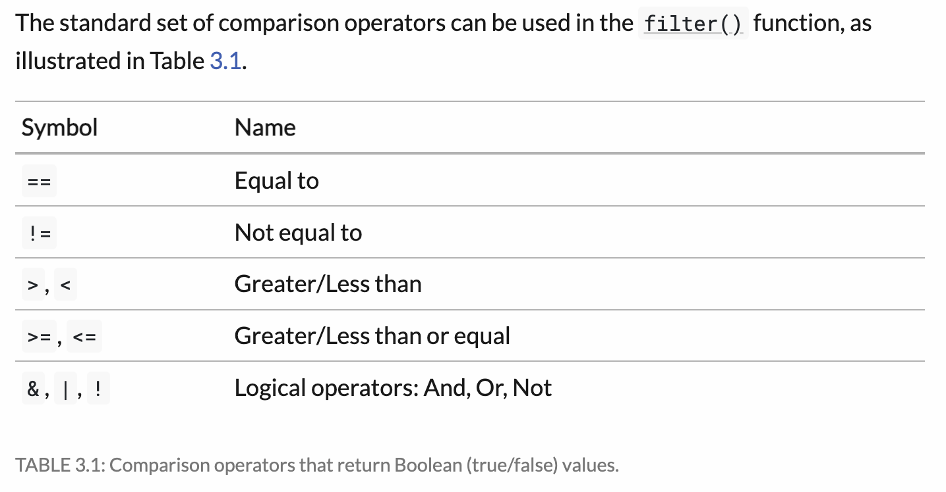

Slide 11
Chaining commands with pipes
%>%
As of R 4.1.0, you can also use |>
The output of a previous function becomes the first argument of the next function, enabling chaining.
The next two are equivalent:
georgia_census <- filter(census_data, st_name == ‘Georgia’)
georgia_census <- census_data |>
filter(st_name == ‘Georgia)
See example in Script 07-1

Slide 12
Spatial operations on vector data
It is important to note that spatial operations that use two spatial objects rely on both objects having the same coordinate reference system.
For more info, see Lovelace Ch 4!

Slide 13
Stats with raster data
Local or per-cell operations: Step 1
Focal or neighborhood operations. Most often the output cell value is the result of a 3 x 3 input cell block
Zonal operations are similar to focal operations, but the surrounding pixel grid on which new values are computed can have irregular sizes and shapes
Global or per-raster operations. That means the output cell derives its value potentially from one or several entire rasters

Slide 14
Terra
Global: "max", "min", "mean", "sum", "range", "rms" (root mean square), "sd", "std" (population sd, using n rather than n-1), "isNA", "notNA", "anyNA", "anynotNA"; or a proper R function (but these may fail for very large SpatRasters unless you specify maxcell)

Slide 15
We are going to do the same thing, but with a geopackage and a raster file.
Task 1:
Read in NLCD raster file and find out the land cover type with the highest percentage of points in Houston.
NLCD = National Land Cover Data: 30x30m from LandSat data

Slide 16
Task 2: Count the number of Starbucks in Houston that occur in each land cover type.
Starbucks: point data
NLCD: raster

Slide 17
Notes for Script 7
Terra has replaced raster
https://cran.r-project.org/web/packages/terra/index.html

Slide 18
NLCD
National Land Cover Data: 30x30m from LandSat data

